Slide 1
Accessibility of Data Visualizations
R packages that support accessible data visualization with a focus on visual impairments
Micaela Lipman

Slide 2
Checklist for accessibility
Do you have alt text?
Are your chart elements and text high contrast?
Are there other ways than color to understand information? Is information dual-coded?

Slide 3
Alt Text
Alt text is so important for individuals who use screen readers.
Recommended alt text format:
“[Chart type] of [type of data] where [reason for including chart].
Cesal, A. (2021, June 8). Writing alt text for Data Visualization. Medium. Retrieved November 11, 2021, from https://medium.com/nightingale/writing-alt-text-for-data-visualization-2a218ef43f81.

Slide 4
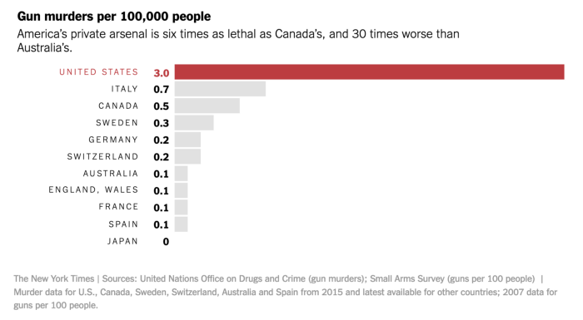
Alt Text Example
Alt text: Bar chart of gun murders per 100,000 people where America’s murder rate is 6 times worse than Canada, and 30 times Australia.”
Cesal, A. (2021, June 8). Writing alt text for Data Visualization. Medium. Retrieved November 11, 2021, from https://medium.com/nightingale/writing-alt-text-for-data-visualization-2a218ef43f81.

Slide 5

Knitr has so many authors and contributors
Christophe Dervieux
Works at Rstudio as a software engineer in the R Markdown team. Contributed to the rmarkdown, knitr, blogdown, and other packages and co-authored the R Markdown Cookbook.

Slide 6
Alt Text In R
In the knitr package, there is a feature to add alt text in R markdown chunks.
```{r, fig.alt = "Scatterplot of flipper length by bill length of 3 penguin species, where we show penguins with bigger flippers have bigger bills."}
ggplot(data = penguins, aes(x = flipper_length_mm, y = bill_length_mm, color = species)) + geom_point(aes(shape = species), alpha = 0.8) + scale_color_manual(values = c("darkorange","purple","cyan4"))
```
Hil, A., Dervieux, C., & Xie, Y. (2021, April 20). New in Knitr: Improved accessibility with image alt text. RStudio Blog. Retrieved November 11, 2021, from https://blog.rstudio.com/2021/04/20/knitr-fig-alt/.

Slide 7
High Contrast
High contrast colors mean that if someone is visualy impaired they have a higher chance of being able to
viridis package in R provides color palettes that print well in grey scale and also ensure high contrast.

Slide 8
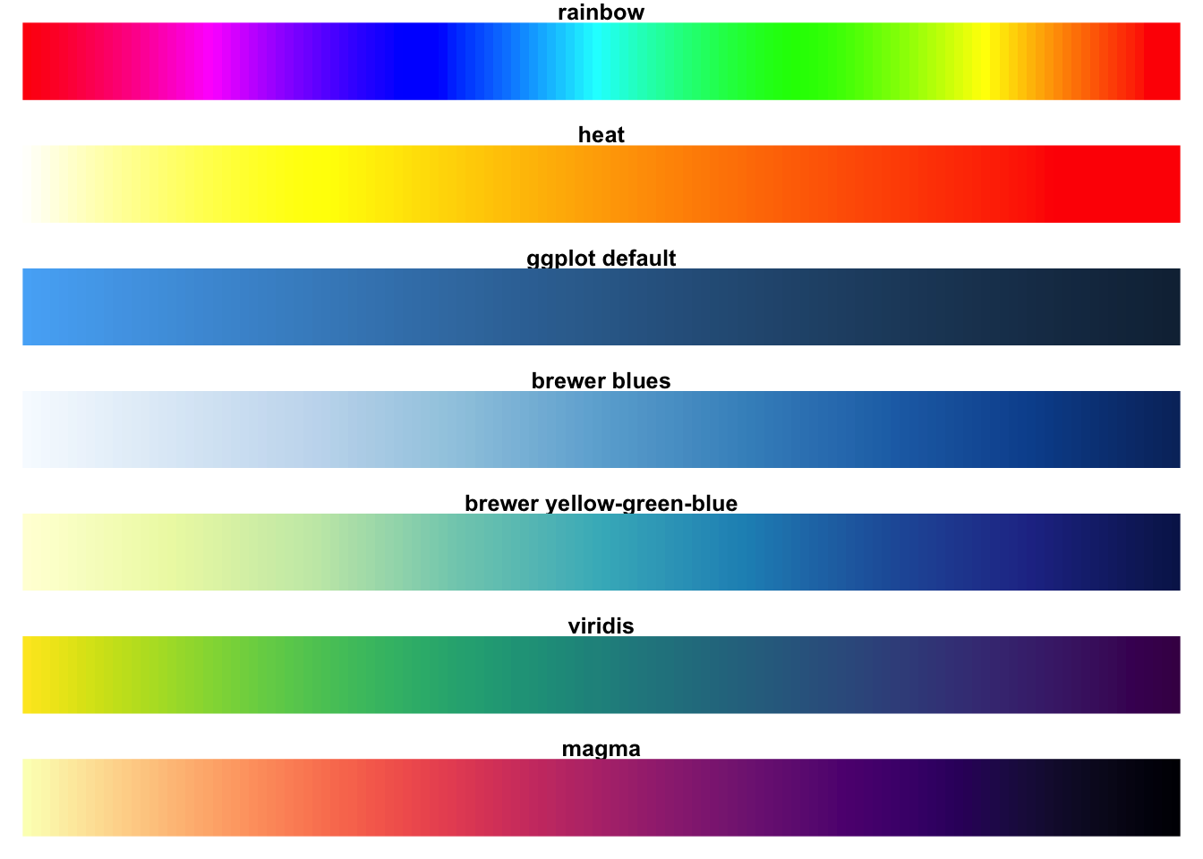
High Contrast Example
Rudis, B., Ross, N., & Garnier, S. (2021, October 13). Introduction to the viridis color maps. Retrieved November 11, 2021, from https://cran.r-project.org/web/packages/viridis/vignettes/intro-to-viridis.html.

Slide 9
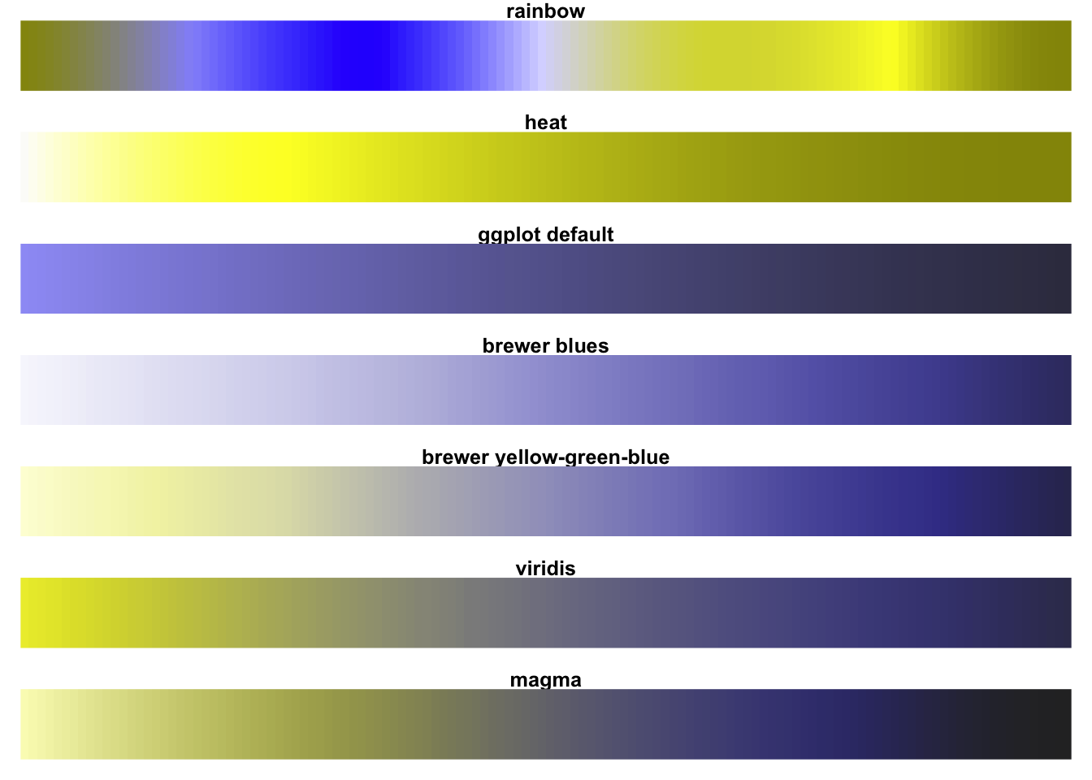
High Contrast Example with Green-Blind colorblindness
Rudis, B., Ross, N., & Garnier, S. (2021, October 13). Introduction to the viridis color maps. Retrieved November 11, 2021, from https://cran.r-project.org/web/packages/viridis/vignettes/intro-to-viridis.html.

Slide 10
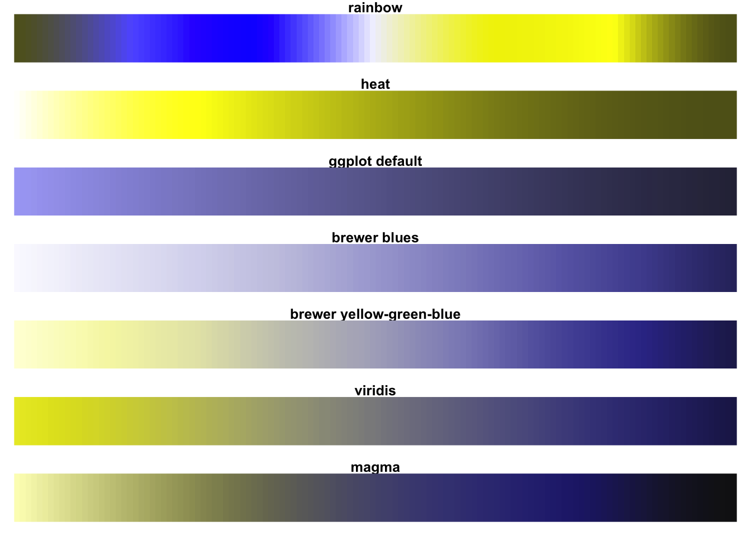
High Contrast Example with Red-Blind colorblindness
Rudis, B., Ross, N., & Garnier, S. (2021, October 13). Introduction to the viridis color maps. Retrieved November 11, 2021, from https://cran.r-project.org/web/packages/viridis/vignettes/intro-to-viridis.html.

Slide 11
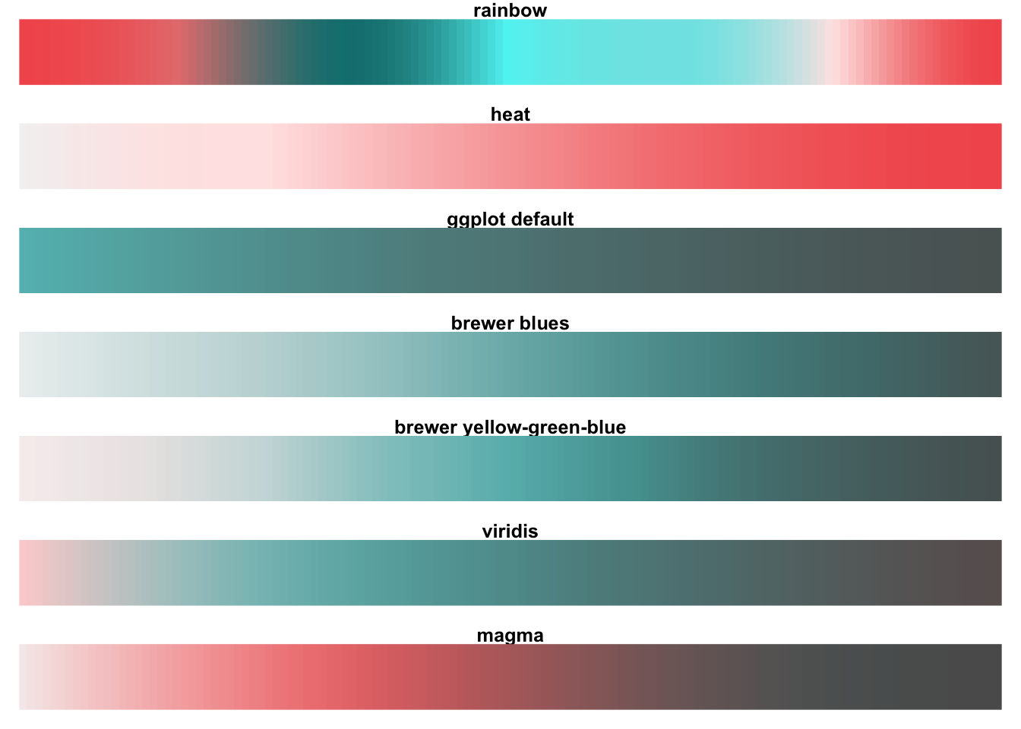
High Contrast Example with Blue-Blind colorblindness
Rudis, B., Ross, N., & Garnier, S. (2021, October 13). Introduction to the viridis color maps. Retrieved November 11, 2021, from https://cran.r-project.org/web/packages/viridis/vignettes/intro-to-viridis.html.

Slide 12
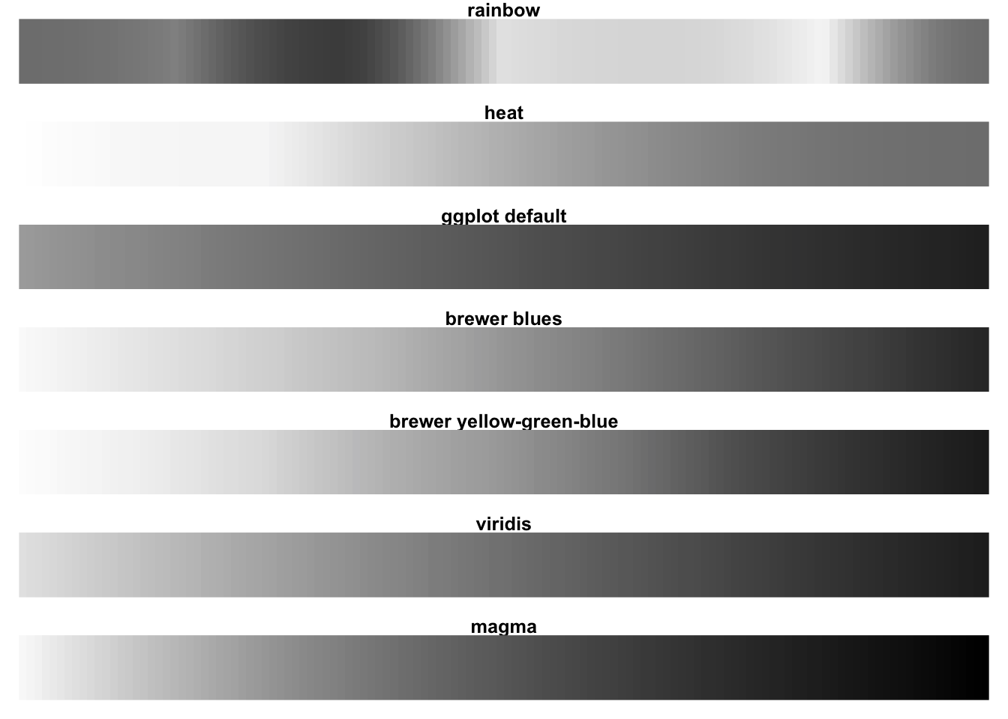
High Contrast Example with complete desaturation
Rudis, B., Ross, N., & Garnier, S. (2021, October 13). Introduction to the viridis color maps. Retrieved November 11, 2021, from https://cran.r-project.org/web/packages/viridis/vignettes/intro-to-viridis.html.

Slide 13


one of the viridis authors
Stéfan van der Walt
Researcher at Berkeley Institute for Data Science, open source scientific Python developer (NumPy, scikit-image, etc.), explorer.
Nathaniel Smith
Currently a freelance software developer with a PhD from UC San Diego in Cognitive Science and Postdoctoral research and Computational fellowships at the University of Edinburgh and UC Berkeley Institute for Data Science.

Slide 14
viridis In R
You can use the viridis package just like we’ve been using color.brewer in class.
ggplot(choropleth, aes(long, lat, group = group)) +
geom_polygon(aes(fill = rate), colour = alpha("white", 1 /
2), size = 0.2) +
geom_polygon(data = state_df, colour = "white", fill = NA) + coord_fixed() + theme_minimal() +
ggtitle("US unemployment rate by county") +
theme(axis.line = element_blank(),
axis.text = element_blank(),
axis.ticks = element_blank(),
axis.title = element_blank()) +
scale_fill_viridis(option="magma")
Rudis, B., Ross, N., & Garnier, S. (2021, October 13). Introduction to the viridis color maps. Retrieved November 11, 2021, from https://cran.r-project.org/web/packages/viridis/vignettes/intro-to-viridis.html.

Slide 15
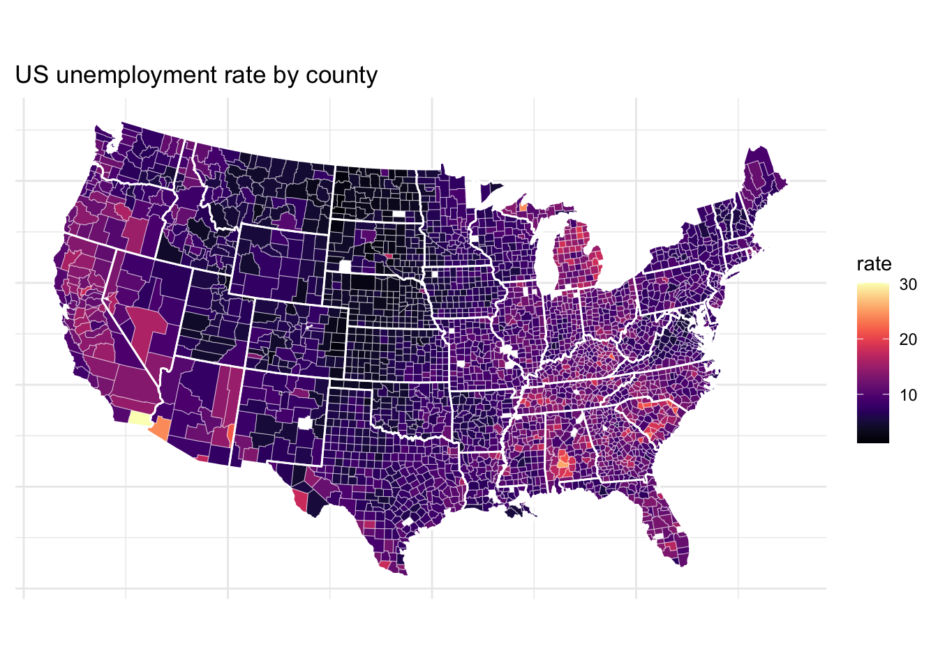
viridis In R
Rudis, B., Ross, N., & Garnier, S. (2021, October 13). Introduction to the viridis color maps. Retrieved November 11, 2021, from https://cran.r-project.org/web/packages/viridis/vignettes/intro-to-viridis.html.

Slide 16
Dual-coding
Dual coding ensures that color is not the only way to understand which data points belong to which group in a legend.
Cesal, A. (2021, June 8). Writing alt text for Data Visualization. Medium. Retrieved November 11, 2021, from https://medium.com/nightingale/writing-alt-text-for-data-visualization-2a218ef43f81.

Slide 17
Dual-coding Bad example

Slide 18
Dual-coding Ok example

Slide 19
Dual-coding Good example
Favorite Animal

Slide 20

ggpattern authors
Trevor L Davis
Postdoctoral Scholar in Economics at the Program on Energy and Sustainable Development at Stanford University.

Slide 21
ggpattern in R
The ggpattern package in R lets you fill plots using patterns.
df1 <- data.frame(trt = c("a", "b", "c"), outcome = c(2.3, 1.9, 3.2))
ggplot(df1, aes(trt, outcome)) +
geom_col_pattern(
aes(
pattern_type = trt,
pattern_fill = trt
),
pattern = 'magick',
pattern_key_scale_factor = 0.7,
fill = 'white',
colour = 'black'
) +
theme_bw(15) +
labs(
title = "ggpattern::geom_col_pattern()",
subtitle = "pattern='magick'"
) +
theme(legend.key.size = unit(2, 'cm')) +
scale_pattern_type_discrete(choices = c('bricks', 'fishscales', 'right45')) +
coord_fixed(ratio = 1/2)
FC, M., & Davis, T. L. (n.d.). Pattern magick - parameters and examples. ggpattern. Retrieved November 11, 2021, from https://coolbutuseless.github.io/package/ggpattern/articles/pattern-magick.html.

Slide 22
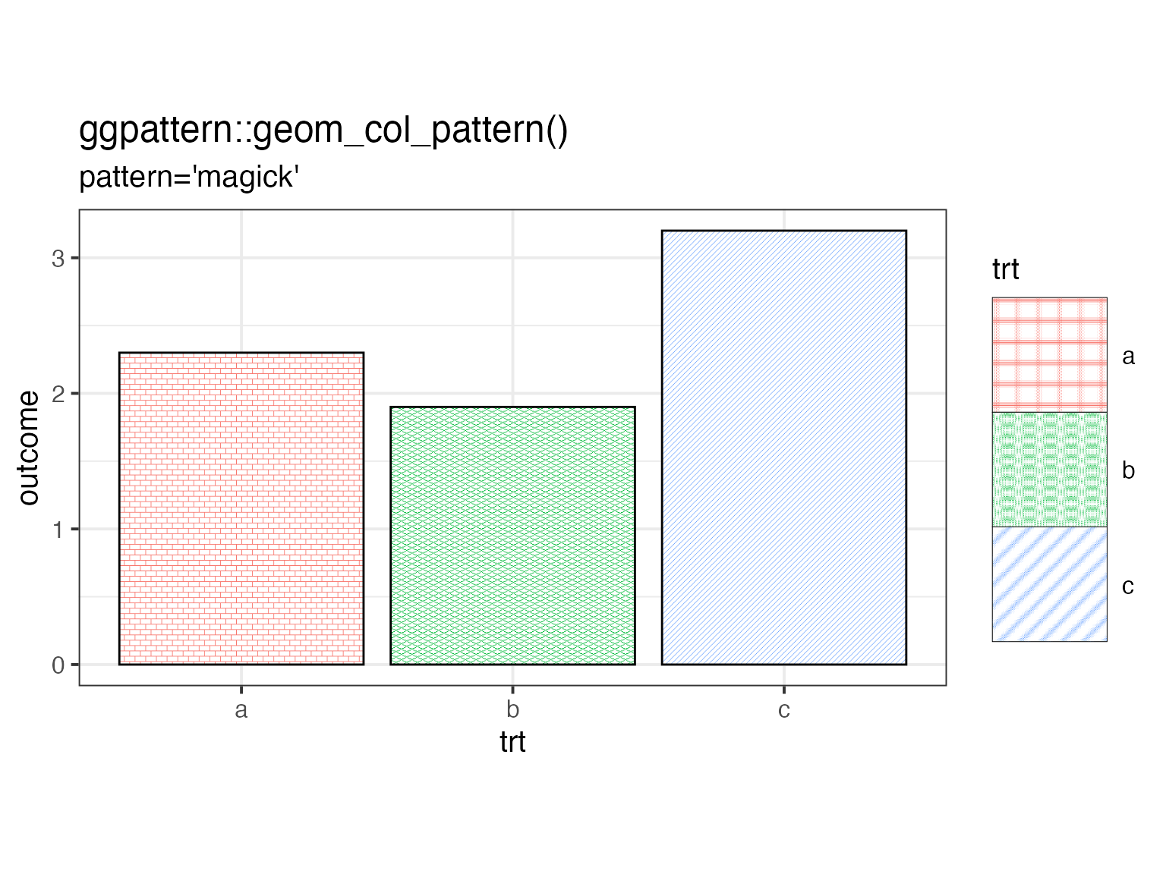
ggpattern in R
FC, M., & Davis, T. L. (n.d.). Pattern magick - parameters and examples. ggpattern. Retrieved November 11, 2021, from https://coolbutuseless.github.io/package/ggpattern/articles/pattern-magick.html.

Slide 23
Questions?

